Slide 1
Palliative and Hospice Care
Dr. Ken Cearlock
Dr. Jim Bell
April 16, 2018

Slide 2
Palliative Medicine
Palliative Medicine is a medical specialty that provides comprehensive, interdisciplinary care for patients with serious illnesses (and their families) with emphasis upon the quality of life and relief of suffering. Palliative Care is provided throughout the trajectory of a disease process without regard to prognosis and can be provided in concert with curative care, as well as near end of life. The Palliative Care team works with patients in conjunction with their primary care physician to address any physical, psychosocial, emotional or spiritual issues the patient may experience.

Slide 3
Palliative Medicine
In other words, palliative medicine is focused on matching care with goals, in the context of serious illness– making sure we understand the right thing to do.

Slide 4
Palliative Medicine Domains
Goals of care
Symptom management
Resuscitation status
Advance Directives/POA
Psychosocial/Spiritual issues
Key components:
Focus on quality of life
Team approach for holistic care
Primary “procedure”: FAMILY MEETING

Slide 5
Primary vs. Secondary Palliative Care
Primary
Core skill set expected of all primary care physicians
Secondary
Skill set and practice pattern peculiar to the new specialty

Slide 6
Typical Diagnoses in Palliative Care
Cancer
Heart Failure
Chronic lung disease
Kidney failure
Dementia/stroke
Multi-system disease

Slide 7
Goals of Care
Common issues
Independence– residence/custodial care, driving
Cognition
“Life support”
Ventilators, tracheostomies
Feeding tubes
Dialysis
Rehospitalization

Slide 8
Symptom Management
Pain
Dyspnea
Anxiety
Delirium
GI symptoms

Slide 9
Advance Directives
Resuscitation/life support
Living will/POA
IPOST

Slide 10
Psychosocial Issues
Family dynamics/systems
Communication
Breaking bad news
Custodial care
Financial
Emotional
Coping strategies

Slide 11
Spiritual Issues
Not religion
Common themes
Connectedness to things/people
Where strength comes from
Why bad things happen
Meaning and purpose
What comes after this life
May profoundly affect decision making

Slide 12
Palliative Care Referral
“Primary”
Talk to your PCP!
“Secondary”
Referral by a physician
St Luke’s– 369-7909
Mercy– 398-6850

Slide 13
Hospice
The subset of palliative care devoted primarily
to comfort care at the end of life

Slide 14
Perspective
"If you can't change something, change the way you think about it."
Mary Engelbreit

Slide 15
Hospice
Caring rather than curing
Treating a patient rather than a diagnosis
Addressing all domains of human suffering rather than isolated organs or parts

Slide 16
Hospice
Affirming a person rather than a victim of disease
Living in spite of illness, not dying because of it
Recognizing dying as a part of living

Slide 17
Hospice
Literally and figuratively, hospice is not a 4-Letter word
Understanding allows us to view hospice differently

Slide 18
Definition of Hospice
A care system designed to give support to people in the final phase of a terminal illness that focuses on comfort and quality of life rather than cure. The goal is to enable patients to be comfortable and relieved of pain and suffering, so that each day can be lived as fully as possible.

Slide 19
Factors that diminish hope
Feeling devalued
Burden
Useless
No purpose
Abandoned or isolated ("Nothing more can be done")
Lack of direction or identified goals
Unrelieved pain and unnecessary suffering

Slide 20
Enhancing hope in terminal illness
Feeling valued
Meaningful relationships
Reminiscence
Humor
Identifying, redefining and realizing goals
Pain and symptom relief
Presence of others
Listening

Slide 21
Hospice
Criteria for hospice admission
Presence of disease which would result in life expectancy of < 6 months if it took its natural course
Goal is for comfort
Hospice is the WAY to take care of the patient, not the PLACE

Slide 22
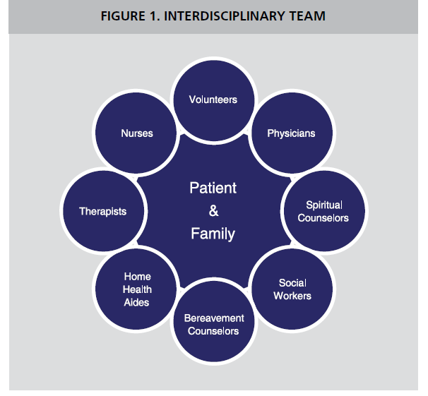

Slide 23
Hospice
Care provided where the patient resides
Coverage for tests or treatment related to terminal condition, including meds
Durable medical equipment
Multi-disciplinary team support
Aggressive symptom management
Respite, inpatient, and continuous care as needed
Bereavement support

Slide 24
Details of Hospice Care
Appropriate for any terminal condition
Prognosis for life expectancy < 6 months
Two physicians certify prognosis
Patient/family elect hospice care
Periodic recertification required
Benefit covers all care related to terminal diagnosis
Revocation is patient/family choice

Slide 25
Hospice Domains
Pain/symptom management
Often creative and out of the box
Not uncommonly very intensive
Activities of daily living
Custodial care issues
Family conflict resolution
Management of unrelated medical problems
Spiritual issues
Financial concerns
Grief and bereavement

Slide 26
End of Life Care in the U.S.
20% of Americans die in their own home
Surveys suggest 70-80% prefer to
Average length of stay in hospice is 21 days (Hospice benefit for 6 months)

Slide 29
Benefits of Hospice
Prioritize goals and directives for care
Avoid care that is not acceptable
Aggressive focus on physical, emotional, social, and spiritual needs
Care comes to the patient and family
Comprehensive team of caring professionals
Insurance coverage for the terminal diagnosis
Hope for living better and perhaps longer
Readily available in our medical community

Slide 30
Hospice Referral
Can be made by anyone
For-profit vs not-for-profit hospices
Mercy 398-6850
St. Luke’s 369-7744

